Slide 1


Green Pace
Security Policy Presentation
Developer: Vincent Valente
Green Pace Developer: Security Policy Template

Slide 2

OVERVIEW: DEFENSE IN DEPTH
Implement core security principles, C/C++ coding standards.
AAA standards, and data encryption standards. Mitigate or halt threats across multiple attack surfaces. Ensure the safety of our customers and integrity of our data (Defense In Depth).

Slide 3
THREATS MATRIX
10 CPP Standards, Organized by severity, priority.
Likely STD-004-SQL, STD-005-MPR, STD-009-SFO, STD-010-SCP | Priority STD-003-STR
Low priority STD-006-AST, STD-007-EXC | Unlikely STD-008-SCP, STD-001-DTP, STD-002-DVL

Slide 4
10 PRINCIPLES
Validate Input Data (Principle 1)
- Applies to Coding Standards: STD-001-DTP, STD-002-DVL, STD-003-STR, STD-004-SQL
Heed Compiler Warnings (Principle 2)
- Applies to Coding Standards: Not explicitly linked in the provided policy details
Architect and Design for Security Policies (Principle 3)
- Applies to Coding Standards: STD-008-SCP
Keep It Simple (Principle 4)
- Applies to Coding Standards: STD-001-DTP, STD-002-DVL
Default Deny (Principle 5)
- Applies to Coding Standards: STD-003-STR, STD-007-EXC, STD-009-SFO, STD-010-SCP
Adhere to the Principle of Least Privilege (Principle 6)
- Applies to Coding Standards: STD-005-MPR, STD-006-AST
Sanitize Data Sent to Other Systems (Principle 7)
- Applies to Coding Standards: STD-010-SCP
Practice Defense in Depth (Principle 8)
- Applies to Coding Standards: STD-004-SQL, STD-009-SFO
Use Effective Quality Assurance Techniques (Principle 9)
- Applies to Coding Standards: STD-006-AST
Adopt a Secure Coding Standard (Principle 10)
- Applies to All Coding Standards

Slide 5
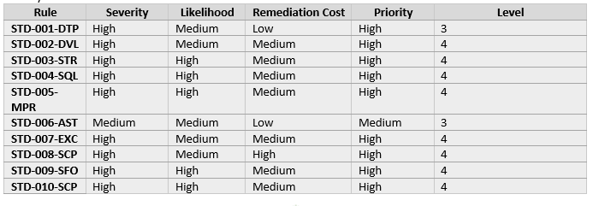
CODING STANDARDS
Data Type
Data Value
String Correctness
SQL Injection
Memory Protection
Assertions
Exceptions
Secure Cryptography Practices
Secure File I/O Operations
Secure Communication Protocols

Slide 6
ENCRYPTION POLICIES
IN REST: Full-Disk Encryption.
AT FLIGHT: Use secure libraries. Use Public Key infrastructure for end-to-end protection. Utilize Data leak prevention built into cloud service.
IN USE: Confirm user roles and identity. Allow access to the tools based on the user roles. User IRM digital rights management.

Slide 7
TRIPLE-A POLICIES
Authentication: Identifying a user
Authorization: Determine what resources are available to that user
Accounting: Monitor and log info about that user and the system

Slide 8
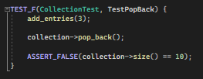
Unit Test 1
TestPopBack : Coding Standard 5 (Secure Memory Management - STD-005-MPR)
This test confirms that pop_back effectively removes an element from the collection and that the size of the collection is updated accordingly. This is crucial for preventing access to "freed" memory which could lead to undefined behavior or security issues such as use-after-free vulnerabilities.

Slide 9
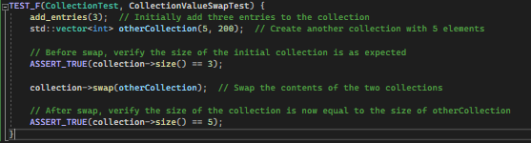
Unit Test 2
CollectionValueSwapTest : Coding Standard 5 (Secure Memory Management - STD-005-MPR) This test ensures that the swap function works as intended, trading the contents of two collections safely. Proper function of swap is vital in contexts where resources are managed and potential memory corruption needs to be avoided.

Slide 10
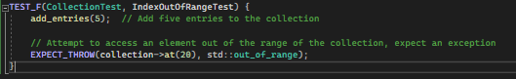
Unit Test 3
IndexOutOfRangeTest : Coding Standard 1 (Strong Type Checking - STD-001-DTP)
This test asserts that the at function throws an std::out_of_range exception when an out-of-bounds index is used, adhering to strong type checking principles. It prevents undefined behavior by ensuring that the program fails fast when a boundary is crossed, which is fundamental for security and stability.

Slide 11
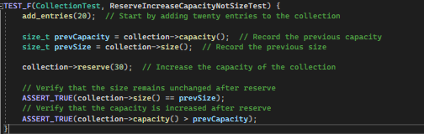
Unit Test 4
ReserveIncreaseCapacityNotSizeTest : Coding Standard 5 (Secure Memory Management - STD-005-MPR)
This test confirms that reserve alters the capacity of the collection without affecting the current size, which is a key aspect of memory management. It ensures that memory is allocated efficiently, and no uninitialized or excess memory is exposed, thus aligning with secure memory management practices and preventing issues like buffer overflows.

Slide 12

AUTOMATION SUMMARY

Slide 13
TOOLS
Automation can be created upon Build, by automating manual processes such as compilation and static code checking into a CI/CD pipeline
Verify and test in SecOps by automating virtualized container deployment
Monitor and detection
Implement automated security test and regression tests in QA
OWASP Dependency-Check
Notable Tools: ClingTidy, Cppchecker, Parasoft, Coverity, Jenkins, Gitlab, Docker

Slide 14
RISKS AND BENEFITS
The Systems Sciences Institute at IBM reported that is cost about 6x more to fix a bug found during implementation than to fix one identified during design.
According to IBM, the cost to fix bugs found during the testing phase could be 15x more than the cost of fixing those found during design.
By documenting the possible or known threats we can address them, then prioritize mitigating them.

Slide 15
RECOMMENDATIONS
Elaborate on presenting metiods and how they can identify and mitigate cyber-security risks in malware and APIs that are used everyday.
Expand on Cloud Security and approaches of the defense in depth at each layer for security.
Security layers include Critical Assets + Data, App Security, Endpoint Security, Host Security, Network Security, Perimeter Security, Cloud Security and Physical Security.

Slide 16
CONCLUSIONS
Adopt a set of tools and mechanisms for Cloud Security
Identify a set of optimal security controls for network and host security.
Read latest forums and journals on security in the field.

Slide 17
REFERENCES
https://wiki.sei.cmu.edu/confluence/plugins/viewsource/viewpagesrc.action?pageId=88042842
Cser, T. (2023, February 13). The cost of finding bugs later in the SDLC. AI Test Automation with Machine Learning. https://www.functionize.com/blog/the-cost-of-finding-bugs-later-in-the-sdlc
Secure coding in C and C++. (n.d.-b). https://insights.sei.cmu.edu/documents/1312/2005_009_001_52710.pdf

